Slide 1

OpenAI API
responses
Three

Slide 2
More Changes!
user
metadata
store
service_tier
stream_options
seed
modalities
n

Slide 3
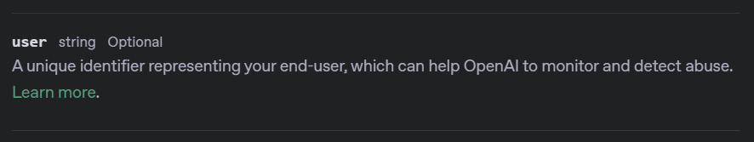
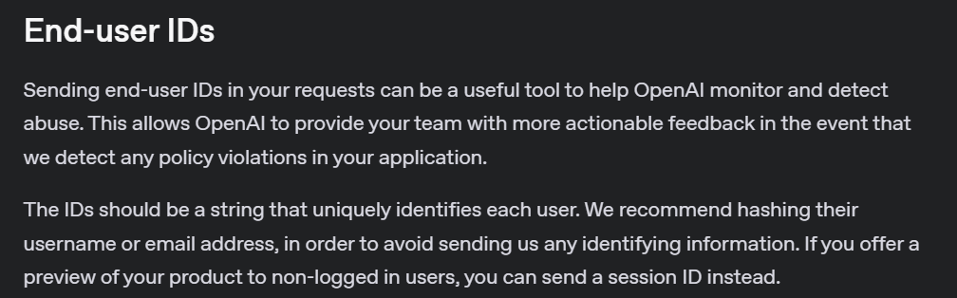
Notes:
https://platform.openai.com/docs/api-reference/responses/create#responses-create-user
https://platform.openai.com/docs/guides/safety-best-practices#end-user-ids

Slide 4
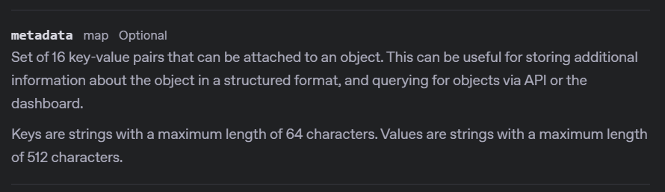
Notes:
https://platform.openai.com/docs/api-reference/responses/create#responses-create-metadata

Slide 5




Notes:
https://www.youtube.com/channel/UC35ZpwldGw7ZJ5R-2sLijzw

Slide 6
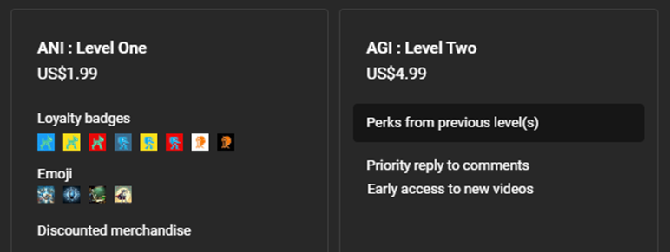
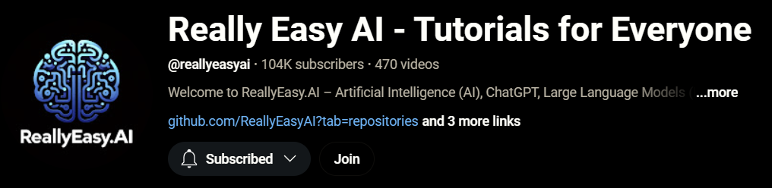
Notes:
https://www.youtube.com/@reallyeasyai/join

Slide 7

https://shop.reallyeasy.ai
Notes:
https://shop.reallyeasy.ai

Slide 8

https://www.youtube.com/@ainewsfresh
Notes:
https://www.youtube.com/@ainewsfresh

Slide 9

https://www.youtube.com/@aipaperspodcastdaily
Notes:
https://www.youtube.com/@aipaperspodcastdaily

Slide 10
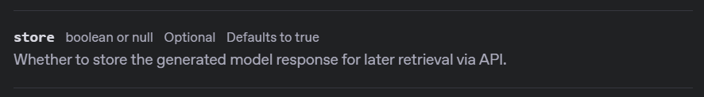
Notes:
https://platform.openai.com/docs/api-reference/responses/create#responses-create-store

Slide 11
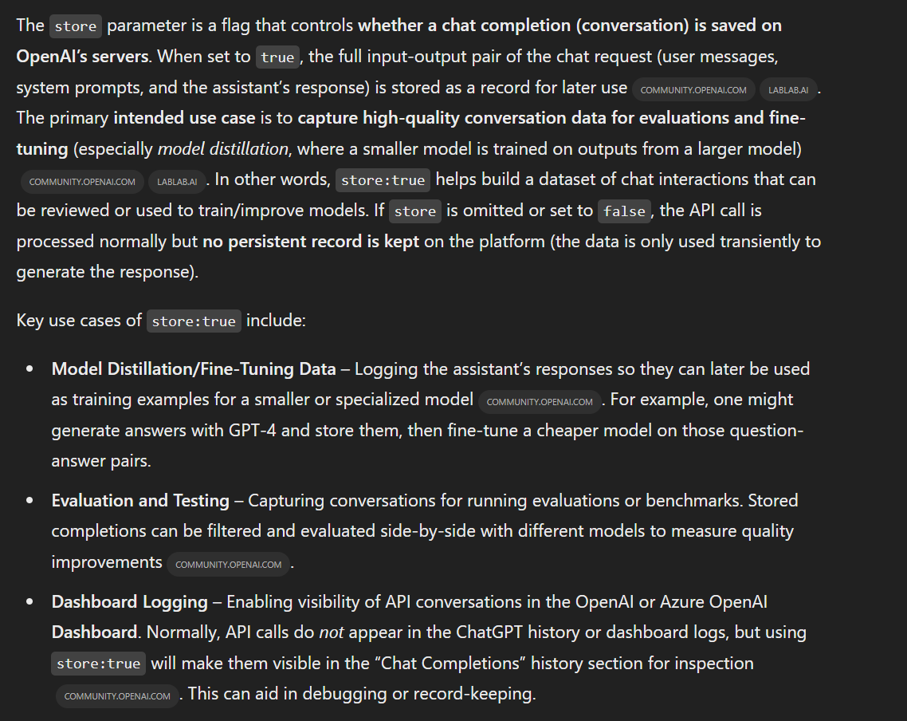
Notes:
https://community.openai.com/t/chat-completions-history-on-openai-dashboard/987804

Slide 12
stream = client.responses.create(
model="gpt-4o-mini",
input=[
{"role": "developer", "content": "You are a brilliant author of children's books."},
{"role": "user", "content": "Write two paragraphs about a frog."}
],
text=None,
temperature=None,
max_output_tokens=None,
top_p=None,
stream=True,
user="user_id_123",
store=True,
metadata={
"project": "Frog Adventures Book Series",
"audience_age": "5-8",
"priority": "medium",
"genre": "educational fiction"
},
)

Slide 13
DEMO: User, Metadata, and Store

Slide 14
OpenAI API
responses
Three

